Slide 1
SW Requirement Analysis

Slide 2

Lesson Objectives
Know level of requirements
Know steps in software requirement process
Know type of requirements
Know steps and activities to develop SRS
Know some methods to estimate effort, cost, schedule

Slide 3
Software Requirement Specifications Development
Section 1

Slide 4
Section 1 - Agenda
Requirement Concepts
Software Requirement Process

Slide 5
Requirement Concepts
Definition
Purpose
Classification

Slide 6
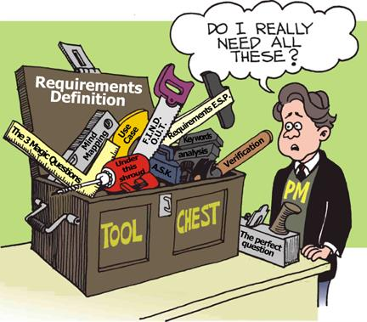
Requirement Definition
What is requirement?
A statement of a service that the system must perform OR.
A statement of a constraint that the system must satisfy.

Slide 7
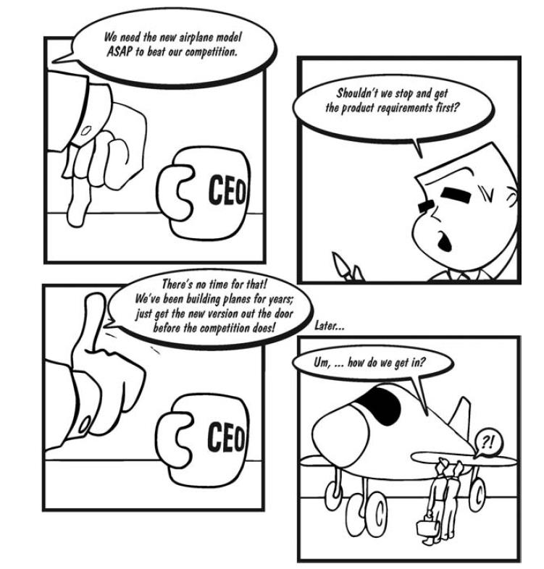
Requirement Definition
Why do we need requirements?

Slide 8
Requirement Purpose
The basis for a bid for a contract – high level of requirements.
Ensure the product satisfies the user – detail of requirements.
Therefore, the requirements can be high-level or detail.

Slide 9
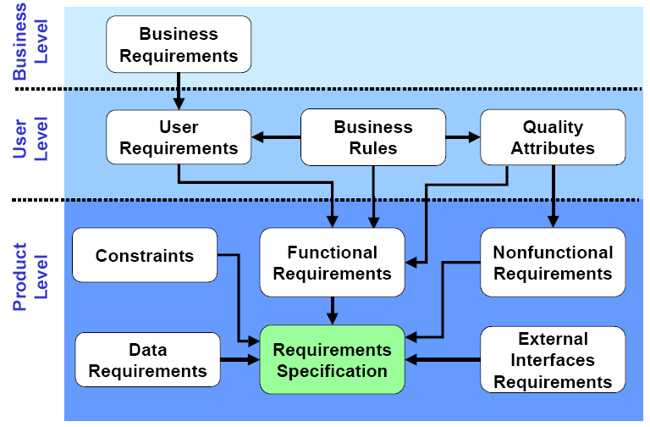
Requirements Classification
Notes:
Business Requirement is statements of objectives and describe why a change has been initiated. For example: They want digital transformation and lead to they want to build a system management software and receive the requests of employees.
Business Rule is a rule that defines a specific constraint within the context of a business. For example: In sales business, if a customer spends more than 10000$ in year then they will receive a discount 10% for next order.

Slide 10
Requirements Classification
Requirement may be classified as
Functional
A function the software has to perform.
Non-functional
A constraints the software must satisfy.

Slide 11
Requirements Classification
Example for functional requirement
Driver should be supported to transmit data in polling mode.
Example for non-functional requirement
Interrupt handler should not take longer than 100us with the core clock is 100Mhz.

Slide 12
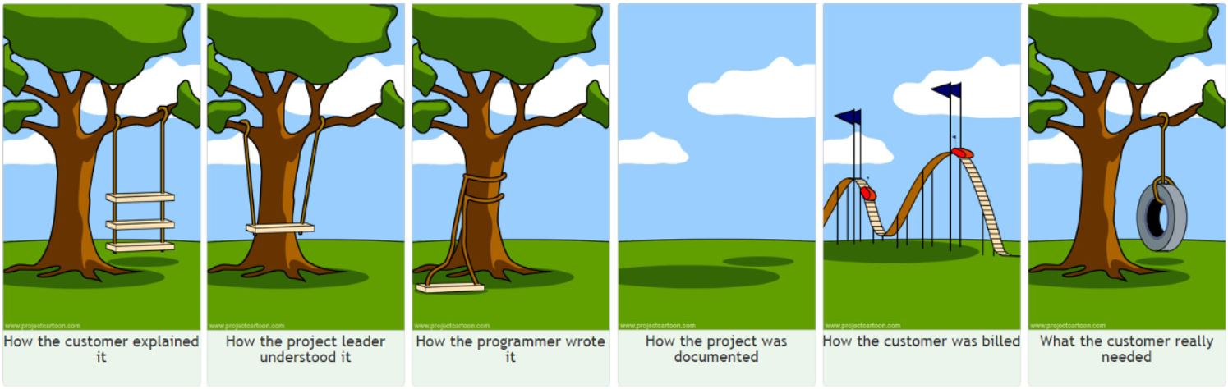
Why requirement is important?

Slide 13
SW Requirement Process – Objectives
To ensure that requirements for the software product are defined and understood.
Get to know what customer’s requirement is
Understand the customers’ needs & expectation
To create SRS - Establish and maintain requirements agreement with the requestor and affected groups
To ensure that the requirements are met.
Requirements are documented and controlled to establish a basis for software development and project management use.

Slide 14
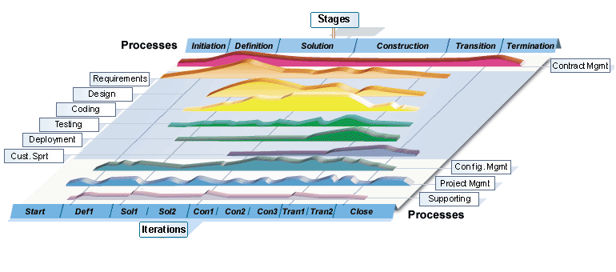
Software Requirement Process
First phase of Software engineering

Slide 15
Software Requirement Process
Elicit & Analyze Requirements
Develop SRS
Validate Requirements
Analysis Records
Review Records
Transfer Requirements
SRS
Requirement Management & Traceability
Manage Requirement Changes
Manage Requirement Status
Manage Traceability
RM Sheet
Change Records
Updated SRS
15

Slide 16
Elicit & Analyze Requirements
Sometimes called requirements discovery
Requirements are often not given to you, you have to elicit them. Must work with customers and relevant stakeholders to elicit:
the services that the system should provide
the constraints that the system should satisfy
Requirement analysis is done to:
Detect and resolve conflicts between requirements
Discover the bounds of the software and how it must interact with its environment
Elaborate system requirements to derive software requirements

Slide 17
Elicit & Analyze Requirements - Process
Identify stakeholders
Understand customer needs
State the problem
Discover requirements
Clarify requirements

Slide 18
Elicit & Analyze Requirements - Techniques
Researching application
Interviewing and questionnaires
Workshop and brainstorming
Storyboarding and role playing
Observation
Use cases
System modeling

Slide 19
Develop SRS – Steps & Activities
Study URD(User Requirements Document):
Analyze user requirement
Prepare Q&A list to clarify unclear items with customers
Call/interview customers if needed
SRS(Software Requirements Specifications):
Develop use cases, system requirement
Develop functional specification
Review and approve SRS:
Call up meeting for review
Keep meeting minutes records
Approved SRS
Document
User Specification Definition
Prepare Q&A, interview end user…
Review SRS document
Develop SRS document

Slide 20
Develop SRS – Techniques
Specify requirements using structured natural language (forms, tables, etc.)
Functional requirements can be specified using modelling - a combination of graphical notations and structured natural language
Use cases
Use case diagrams
Use case specifications
Non-functional requirements can be specified using structured natural language.

Slide 21
Validate Requirements – Purpose
Make sure that the requirements define the system that the customer really wants
Requirements error costs are high so validation is very important

Slide 22
Validate Requirements – Process
Validity check
Consistency check
Completeness check
Realism check
Verifiability check

Slide 23
Validate Requirements – Techniques
Requirements Review
Systematic manual analysis of the requirements
Involving development staff, customers and relevant stakeholders

Slide 24
Transfer requirements
Transfer knowledge meetings
Understand customer, system, business overview
Overview about functions.
Brainstorm meeting: tester and developer present their understanding -> cross check between BA, Dev and Test.

Slide 25
Requirement Traceability
Why is traceability necessary?
Review
Non-traceable requirements
100%
Software requirements
100%
Test Cases
Traceable requirements
100%
Design Items
100%
Code Items
Notes:
The requirements can change at any stage during the product’s life.
If the requirements are traceable, then when changes happen, it is far easier to find the impacted parts of the product.
Ensure all requirements are verified by test case if they can testable.
Ensure all requirements are covered by the product

Slide 26
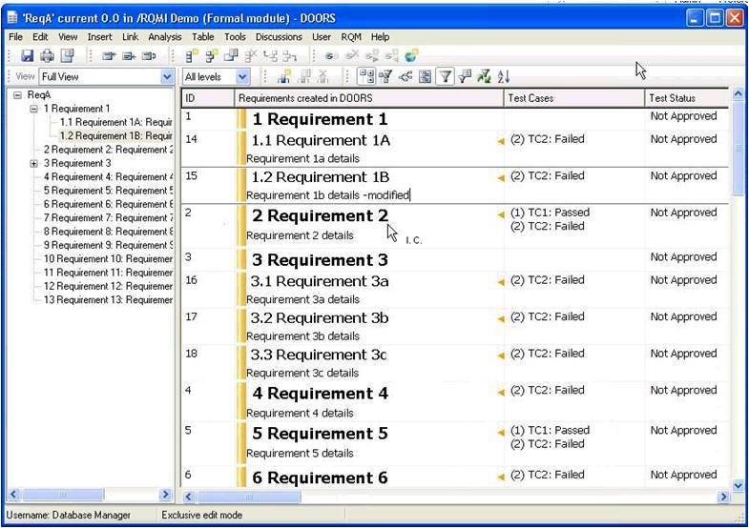
Requirement Traceability
Example: How to check traceability in a software product?
Use a software requirements management tool like IBM Rational DOORS

Slide 27
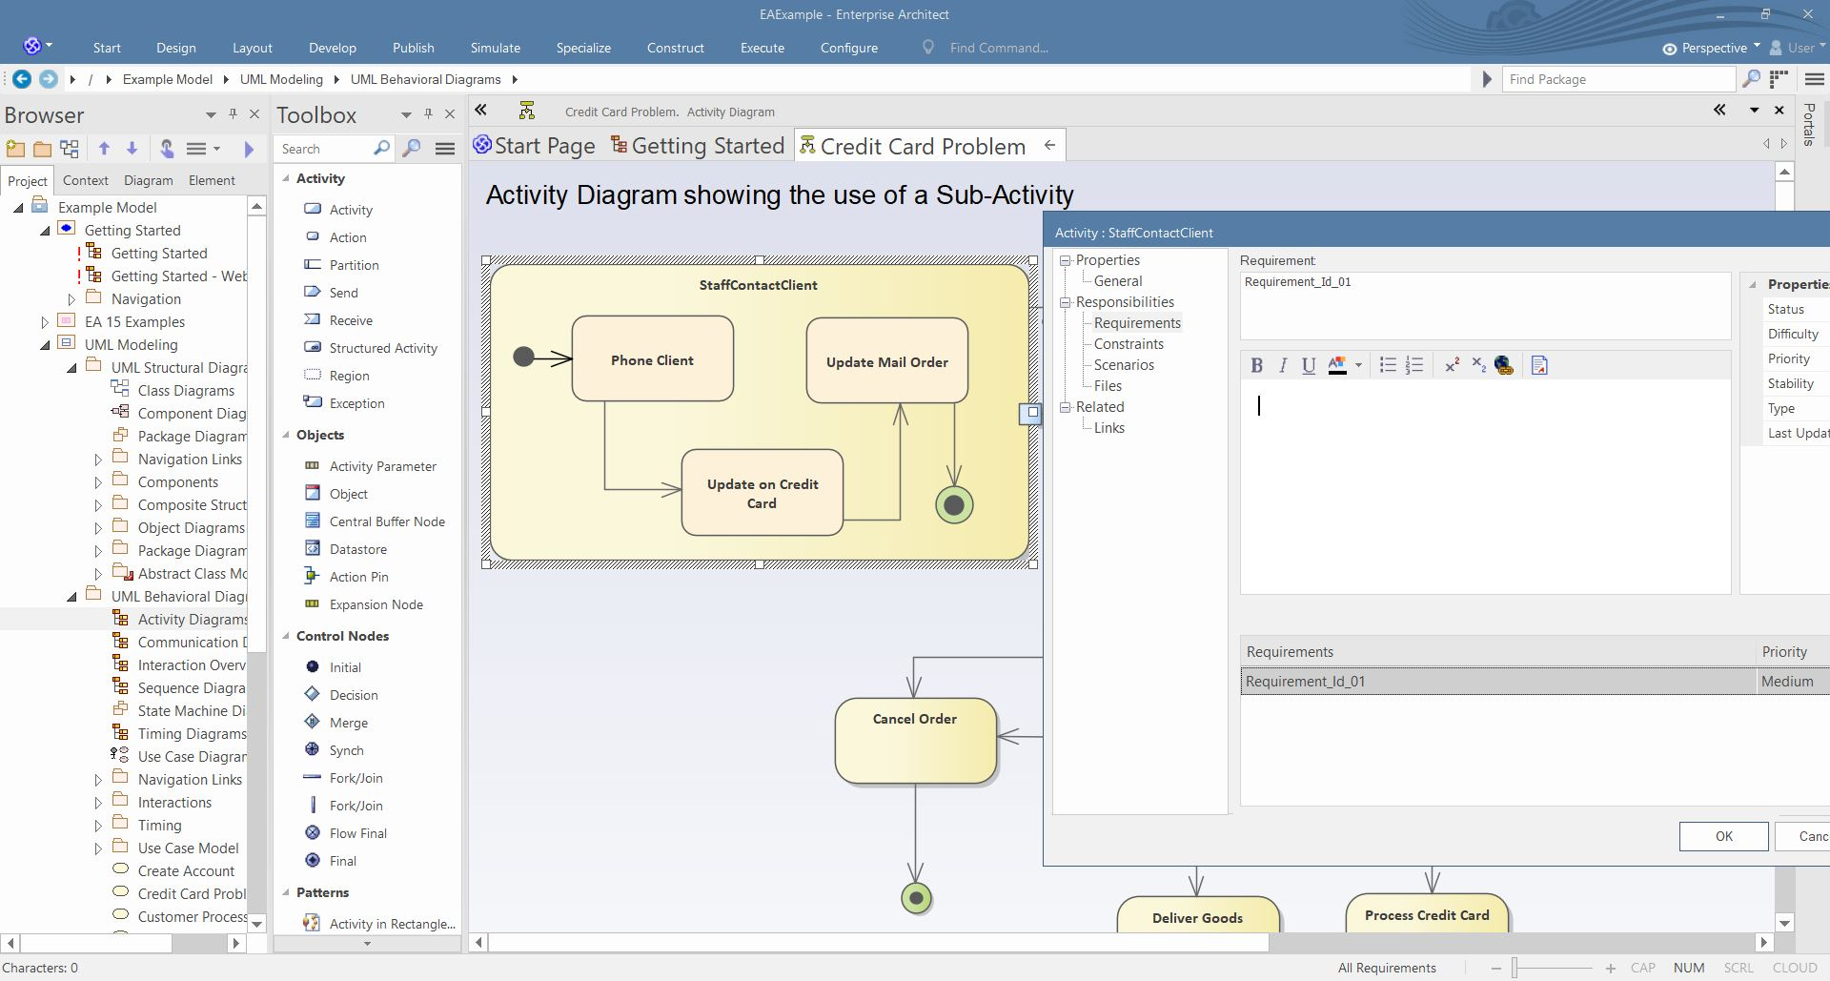
Requirement Traceability
Example: How to check traceability in a software product?
Use a design tool like Sparx Systems Enterprise Architect
to support linking requirements in each component, item of the design model

Slide 28
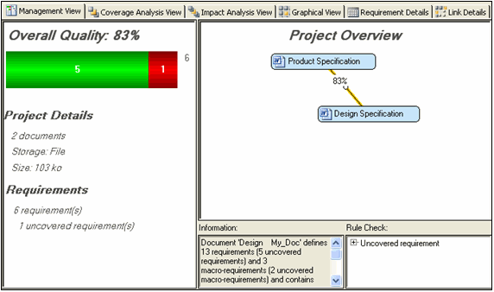
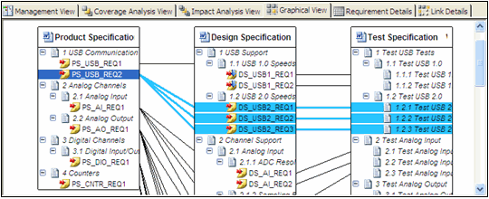
Requirement Traceability
Example: How to check traceability in a software product?
To check link between source code, design and verification documents with requirements stored in documents and databases.
Use a requirements traceability tool like Mentor’s ReqTracer.

Slide 29
Estimation and Schedule Methods
Section 2

Slide 30
Section 2 - Agenda
Introduction
Estimation techniques

Slide 31
Introduction
Why estimation is the most important in every project?
To identify the effort in person month or person day
To identify the project duration and milestones
To identify budget
To find risks which may happen during project implementation
Software estimation is a continual process that should be used throughout the life cycle of a project. The software estimation process consists of some activities such as:
Estimate effort & cost
Estimate schedule

Slide 32
Introduction
Estimation techniques:
Expert Judgment
Analogous Estimating
Three-Point Estimating
Critical Path Method
Critical Chain Method
Work Break-down Structure Estimation

Slide 33
Expert Judgment
Guided by historical information
Can provide duration estimate information or recommended maximum activity durations from prior similar projects
Determine whether to combine methods of estimating and how to reconcile differences between them

Slide 34
Analogous Estimating
Technique for estimating the duration or cost of an activity or a project using historical data from a similar activity or project
Analogous estimating uses parameters from a previous similar project, such as duration, budget and complexity, as the basis for estimating the same parameter or measure for a future project

Slide 35
Three-Point Estimating
Triangular distribution: tE = (tO + tM + tP)/ 3
Beta distribution: tE = (tO + 4tM + tP)/ 6
Final estimate: tE Most likely estimate : tM The best-case estimate : tO The worst-case estimate : tP
Example:
Task A: tO = 6 hours , tM = 10 hours , tP = 14 hours
tE = (6 + 10 + 14 ) / 3

Slide 36
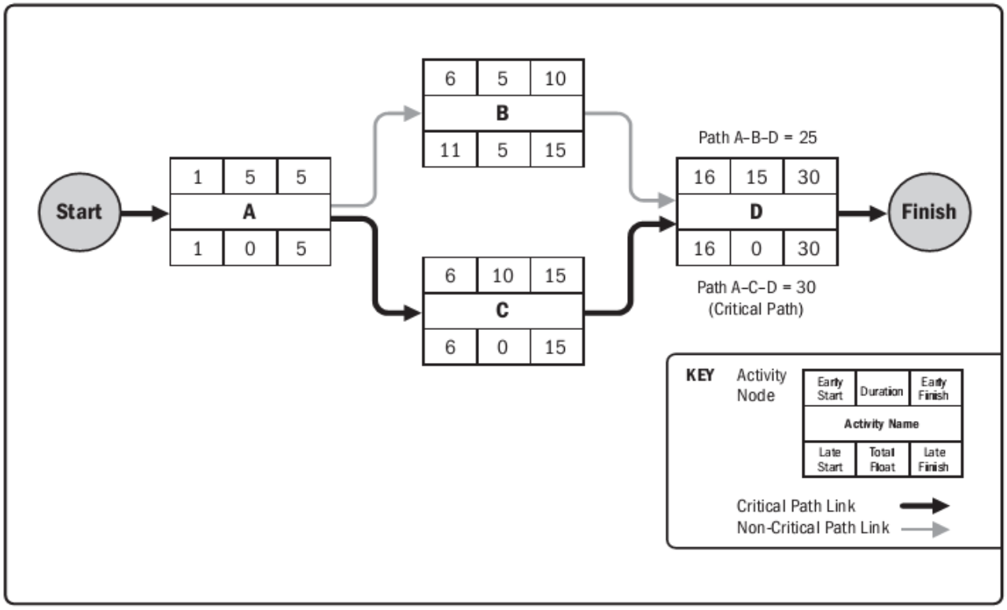
Critical Path Method
Notes:
– The Critical Path is the string of activities that will delay the whole project if any one of them is delayed – Float: is the amount of time that it can slip before it causes your project to be delayed

Slide 37
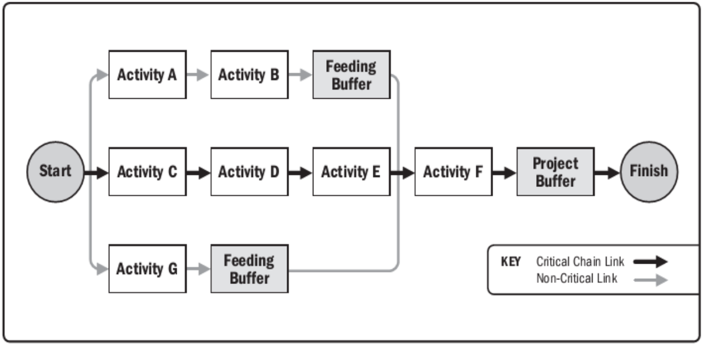
Critical Chain Method

Slide 38
Work Break-down Structure Estimation
The project work is first divided into a hierarchy of tasks (or units), which is called Work Break-down Structure
The estimated effort of the whole project is total of each tasks
There are 2 approaches to divide the works:
Program module(Module-based WBS estimation)
Project’s activities(Activity-based WBS estimation)

Slide 39
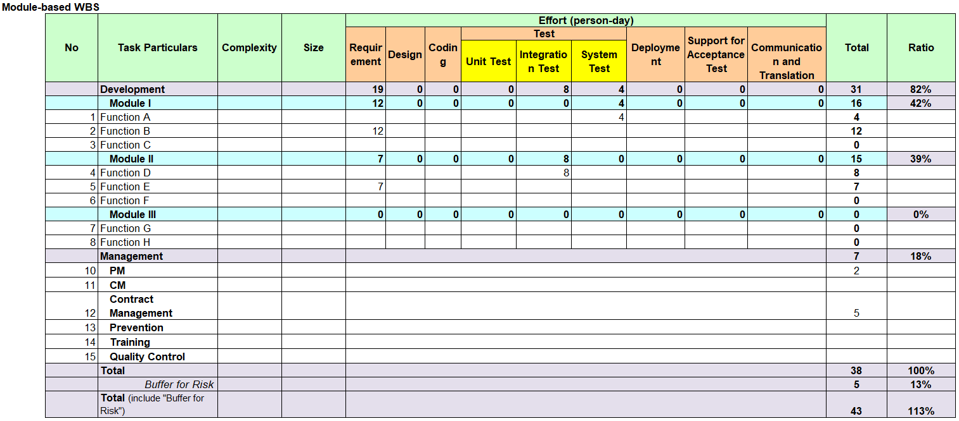
WBS estimating sample

Slide 40
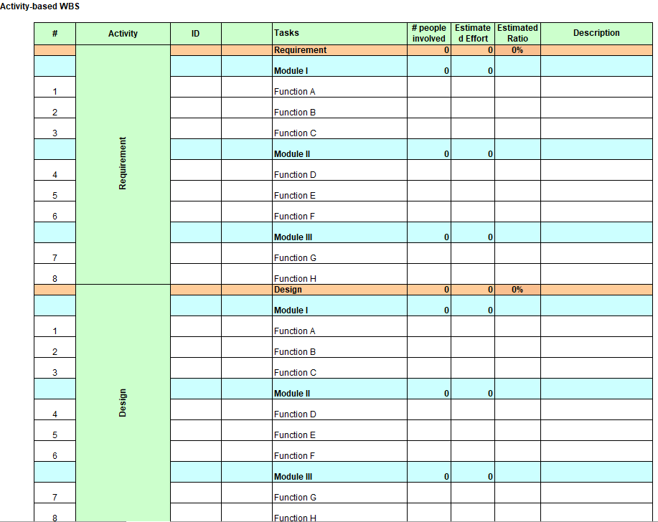
WBS estimating sample

Slide 41

Thank you

